Slide 1
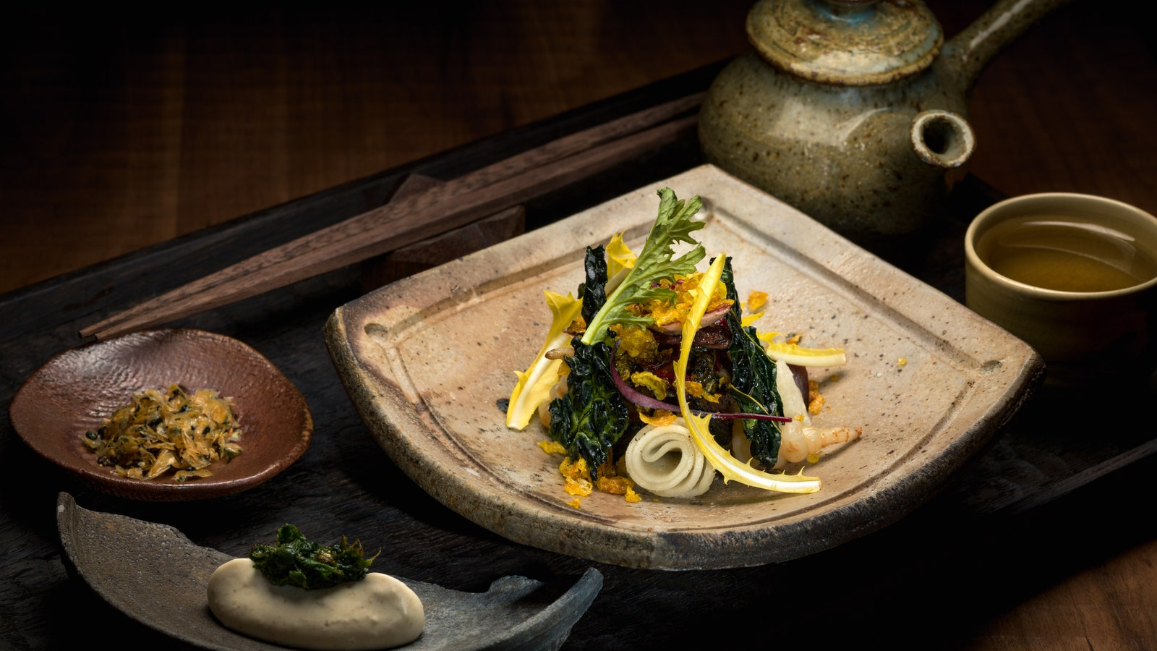
Tasty Bytes: Predicting Popular Recipes
George Slade –
Data Science Team
Notes:
Intro, name and team along with brief background on the task from the Product Team (identifying popular recipes)

Slide 2

Agenda
Business Goals
Project Summary
Key Findings and Current Performance
Recommendations/Next Steps
Notes:
Agenda run through: business goals to identify popular recipes, steps taken through the project (initial data cleaning, analysis and then modelling for outcome), key findings from project and how chosen model delivered on KPI for Product Team, recommendations and next steps off the back of work done

Slide 3

Business Goals
Popular recipes displayed on the home page of Tasty Bytes drive further traffic to the rest of the website, which drives increased subscriptions.
The Product team have provided a dataset containing recipe information and would like to know:
Can the recipes that lead to high traffic be predicted?
If so, can these predictions be correct 80% of the time?
Business Goal – Identify most popular recipes for homepage
Notes:
Highlight drive for increased subscriptions underpinning business goal of identifying popular recipes. Product team want to know two things, both of which fall under the banner of identifying popular recipes

Slide 4

Project Summary – Initial Look
947 recipes provided for analysis
Data includes:
Recipe ID
Calories
Carbohydrate
Sugar
Protein
Category (Chicken, One Pot Dish, Dessert etc.)
Servings
High Traffic
Data cleaned and validated before initial analysis
Notes:
Summary of data provided, high traffic flag is the most important for us and we will use other variables to predict this, see how they link in to it once the data had been cleaned and validated

Slide 5
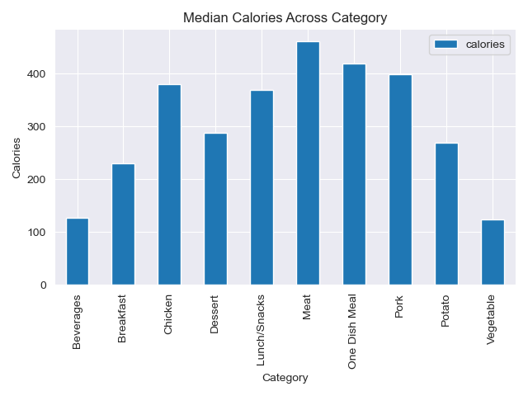
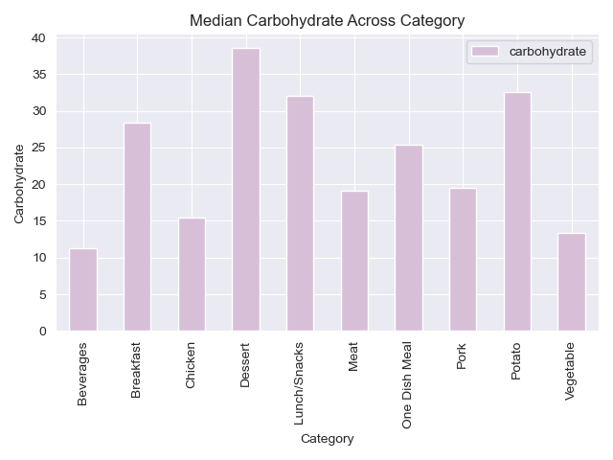

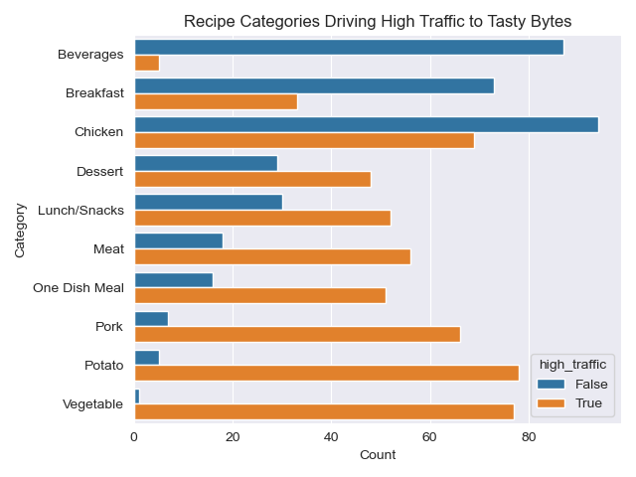
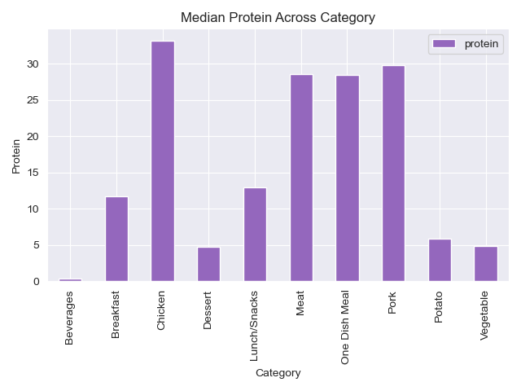
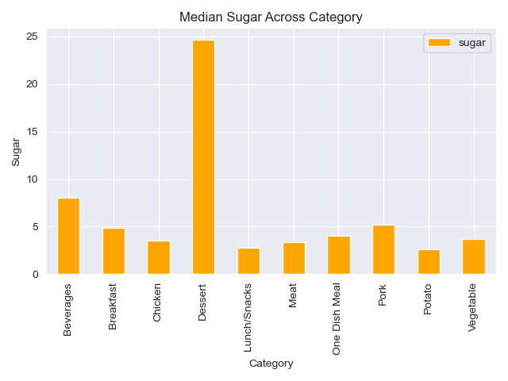
Project Summary – Exploratory Analysis
Notes:
Initial analysis focusing on popularity by category first, interesting note on chicken being both third highest gross popularity and third lowest net popularity. Then median value across each category for food groups, not symmetrical between food groups and no real link apart from a slight suggestion between protein and calories but nothing conclusive at all

Slide 6
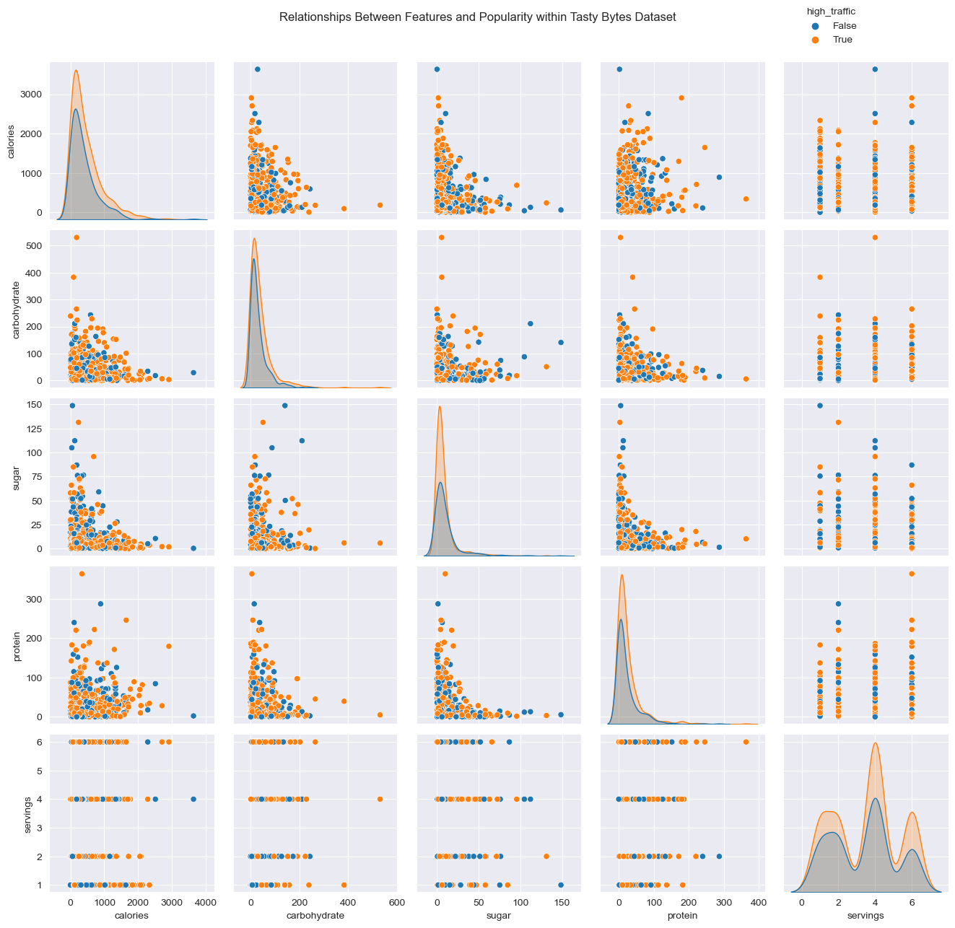
Notes:
Looking at relationship between numeric features now and popularity, no real pattern between readings that are popular and those that aren’t, similar distributions seen for popular/not popular across all features here

Slide 7

Project Summary – Modelling
Binary Classification
Data Pre-Processing
Model Training/
Testing
Selection of models tested –
Looking for models with high precision
Notes:
Flow chart of work to be carried out with initial analysis now done: identify problem type (Binary Classification), prepare data for modelling (convert categorical variables to numbers and normalise/transform numeric data to account for outliers), then employ a selection of models to train/test on the data to see what kind of predictions can be made. Emphasise precision (want models that are good at identifying popular recipes specifically)

Slide 8

Key Findings and Current Performance
Vegetable/Potato/Pork recipes consistently popular, Beverages/Breakfast recipes consistently unpopular
KPI to monitor: High Traffic Conversion Rate (HTCR)
HTCR ≥ 4 (above 80%) needed, any less won’t meet requirements
Logistic Regression model is the best option
Model | Precision Score | HTCR Score
Logistic Regression | 82.98% | 4.88
Gradient Boosting Classifier | 82.95% | 4.87
Notes:
Some recipes popular, some not within dataset, designed KPI called High Traffic Conversion Rate: how well the chosen models predict recipes as correctly popular (True Popular recipes over False Popular recipes), want this value above or equal to 4 to meet the requirements laid out by product team. Logistic Regression model is the best option for this!

Slide 9

Next Steps
Further data for training/testing models, continue to iterate on performance
Potential usage of Neural Networks to allow for image data in classification
Evaluate whether to drop low traffic recipes (Beverages/Breakfast) from home page rotation
Notes:
More data needed! Keep working with models to see if more performance can be eked out, could include other sources of data for improved classification, need to decide whether to drop unpopular recipes from home page.

Slide 10

Recommendations
Productionise best model to classify whether new Tasty Bytes recipes added to website are popular or not, for homepage display
A/B Testing of recipe display, to see if more clickthrough is generated
Monitoring and improvement of model performance through iterative testing/training, keeping on eye on model drift
Notes:
First recommendation would be to productionise model to work with incoming new recipes, give a probability of popularity based on model training. AB test of how recipes are displayed to see if things can be tweaked to improve clickthrough to main site. Monitoring of model performance on data, making sure that performance doesn’t tail off drastically with changing data.

